Slide 1
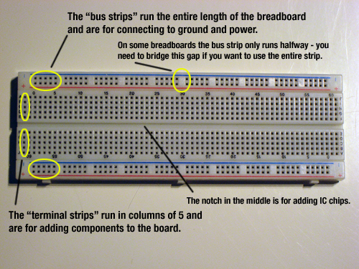
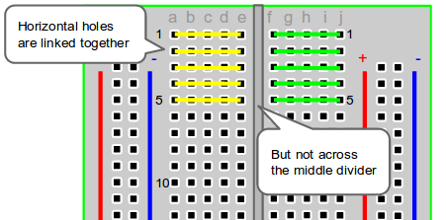
Breadboard
http://computers.tutsplus.com/tutorials/how-to-use-a-breadboard-and-build-a-led-circuit--mac-54746
http://tymkrs.tumblr.com/post/6386624174/how-to-use-a-breadboard

Slide 2
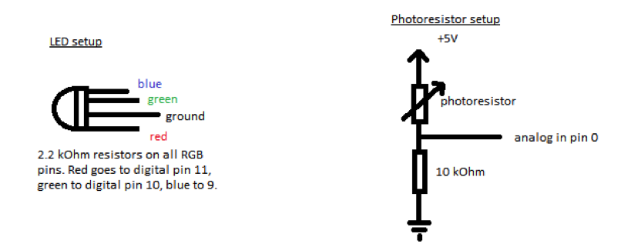
LEDs and Voltage Dividers

Slide 3
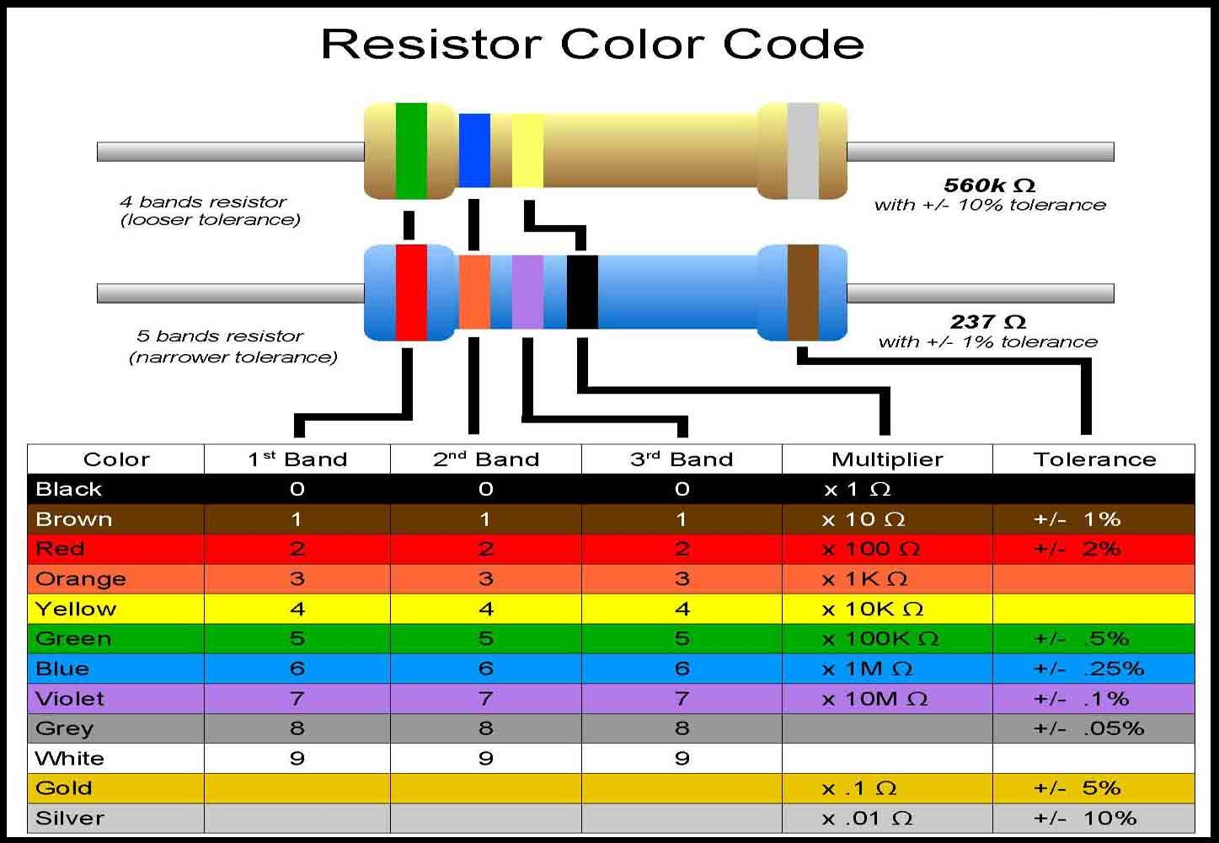
Resistors!
http://www.google.com/imgres?imgurl=&imgrefurl=http%3A%2F%2Fdiy-stem.org%2Fknatom%2Fresistors%2F&h=0&w=0&tbnid=VbUoXDea
7PenhM&zoom=1&tbnh=187&tbnw=270&docid=zo0TrBBZQS2NVM&tbm=isch&client=ubuntu&ei=KpXEU76BLu3hsASLzYHoBw&ved=0CAUQsCUoAQ

Slide 4
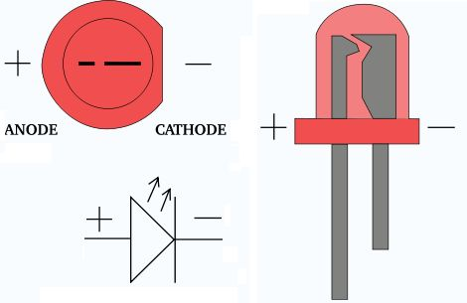
More LEDs
http://www.instructables.com/id/LED-Polarity-Tester/

Slide 5
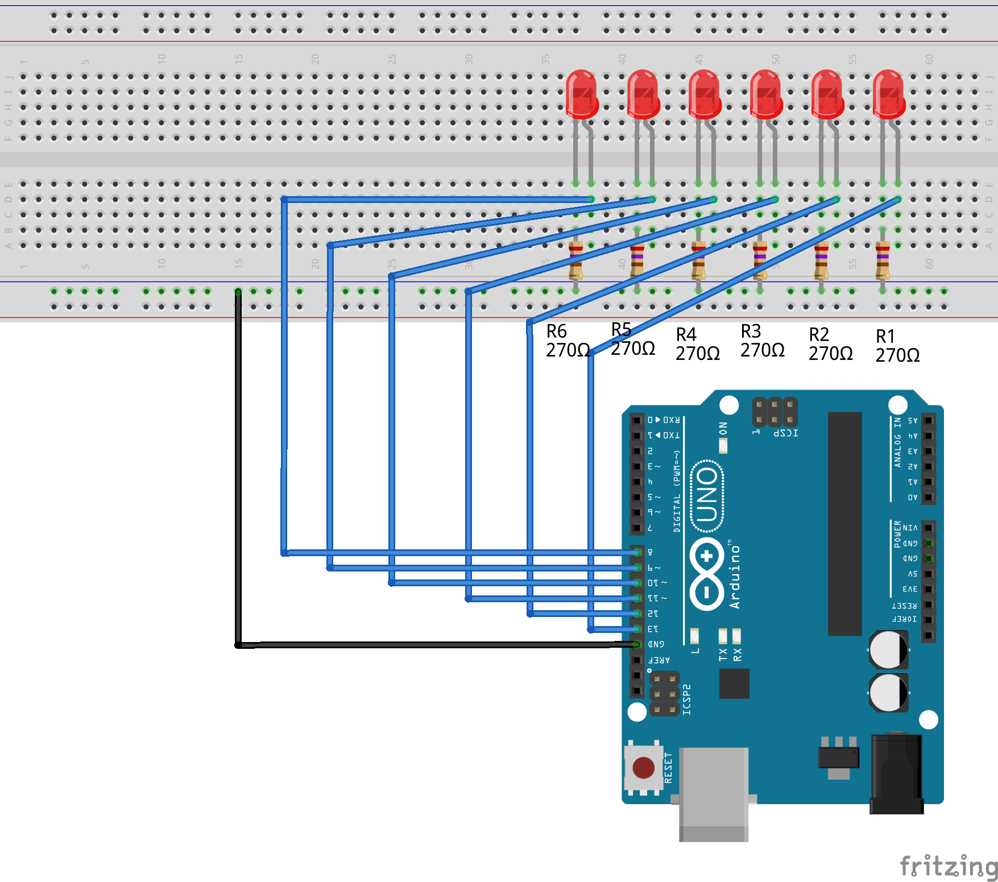
Die Circuit

Slide 6
Die Parts
6 - LEDs
6 - 270 Ohm Resistor

Slide 7
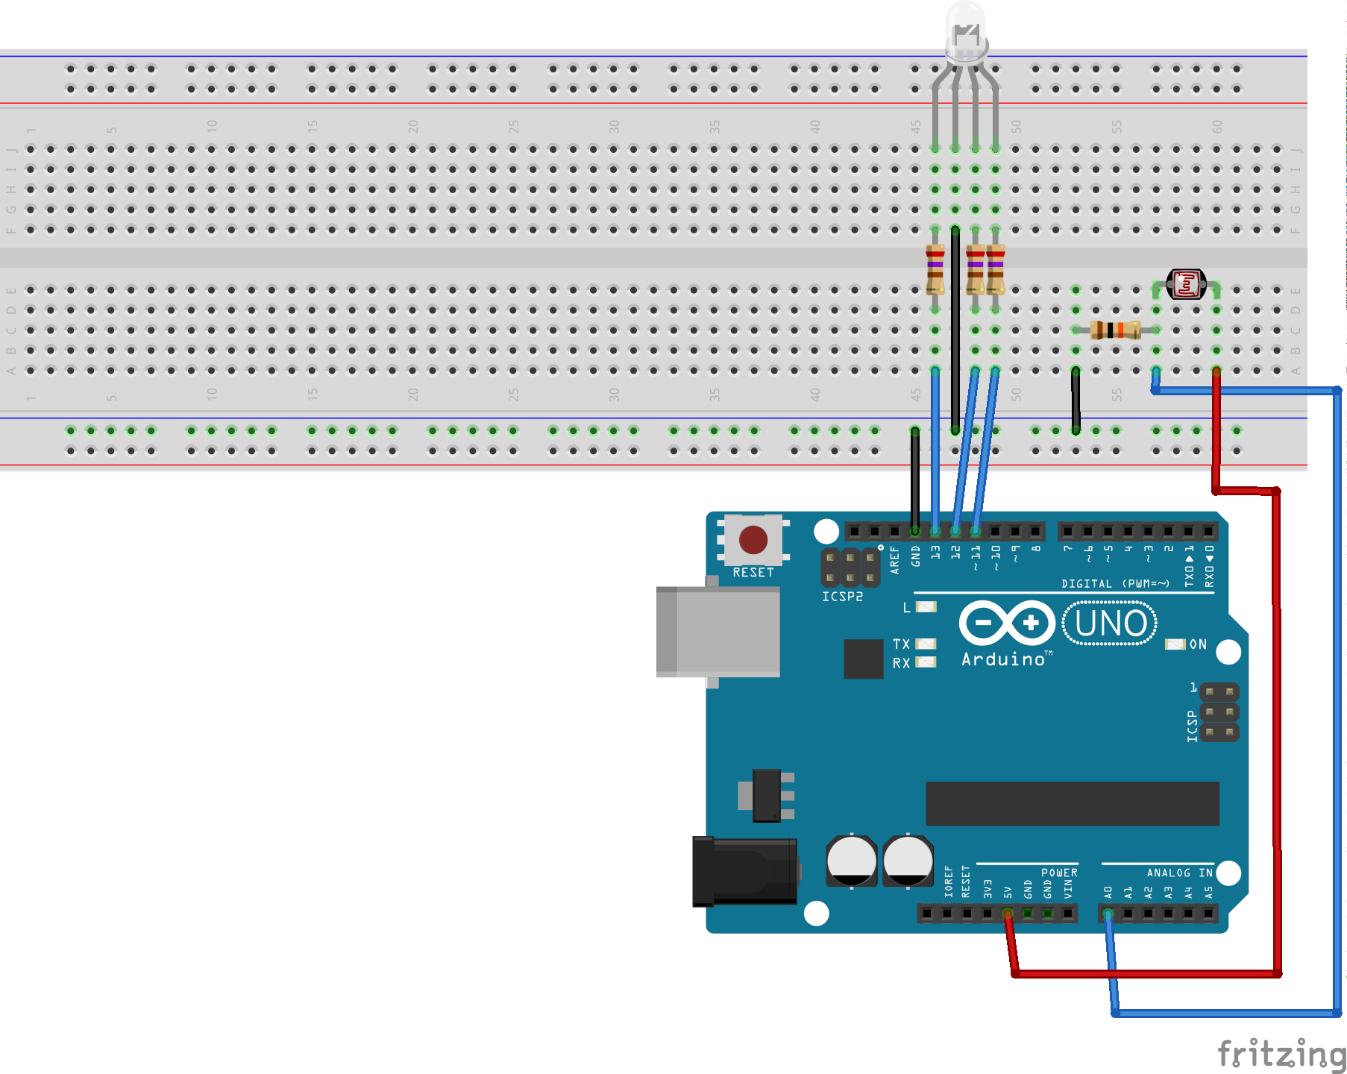
Distance Detection Circuit

Slide 8
Distance Detection Parts
3 - 270 Ohm resistor
1 – 10K Ohm resistor
1 – Photo-resistor

Slide 9
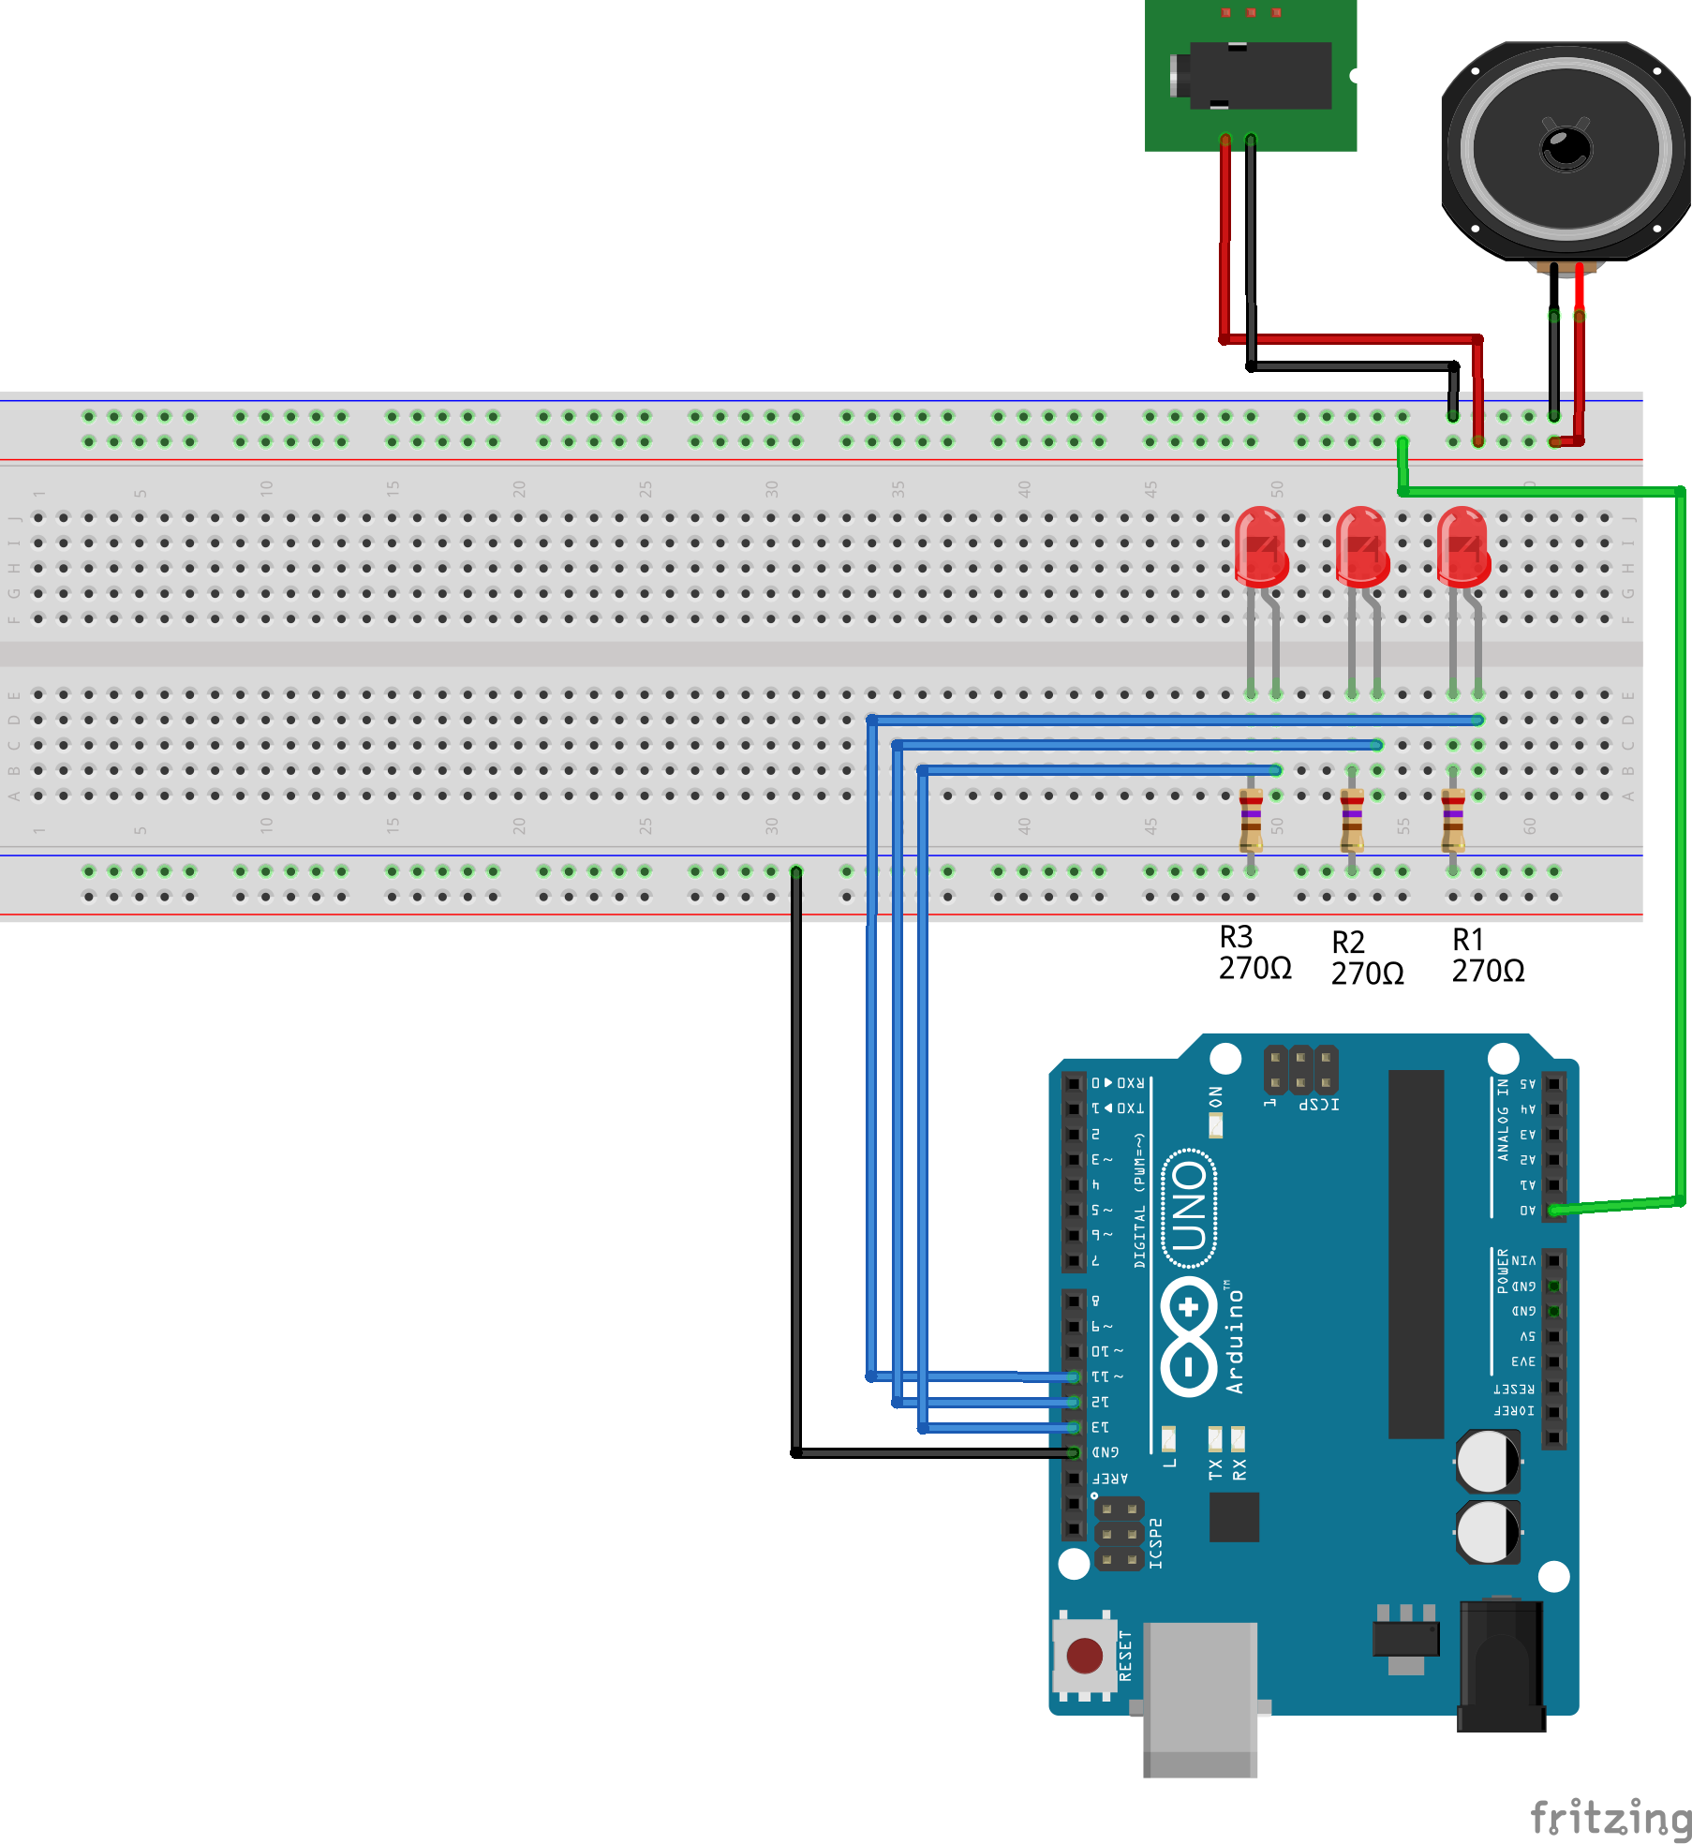
Party Lights Circuit

Slide 10
Party Lights Parts
1 – Speaker
1 – Audio Jack
3 – LEDs
3 – 270 Ohm resistors

Slide 11
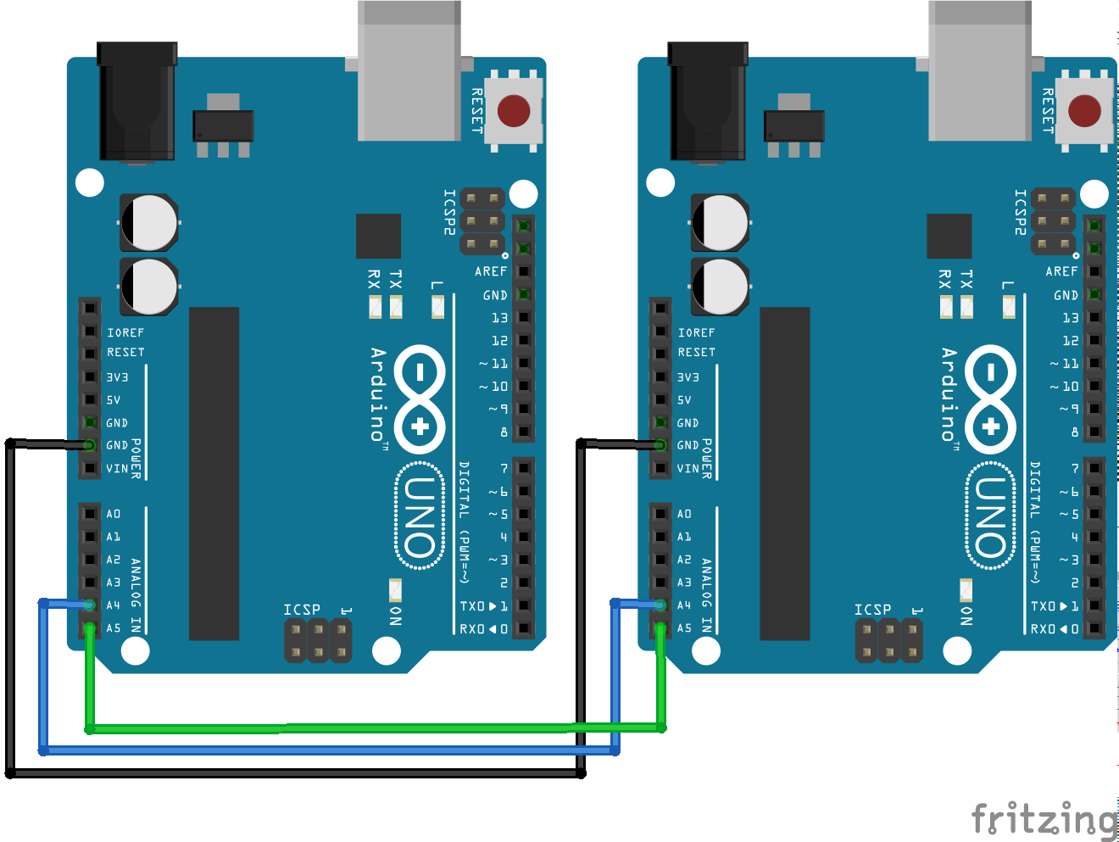
Chat Circuit

Slide 12
Chat Parts
2 - Arduinos

